Slide 1
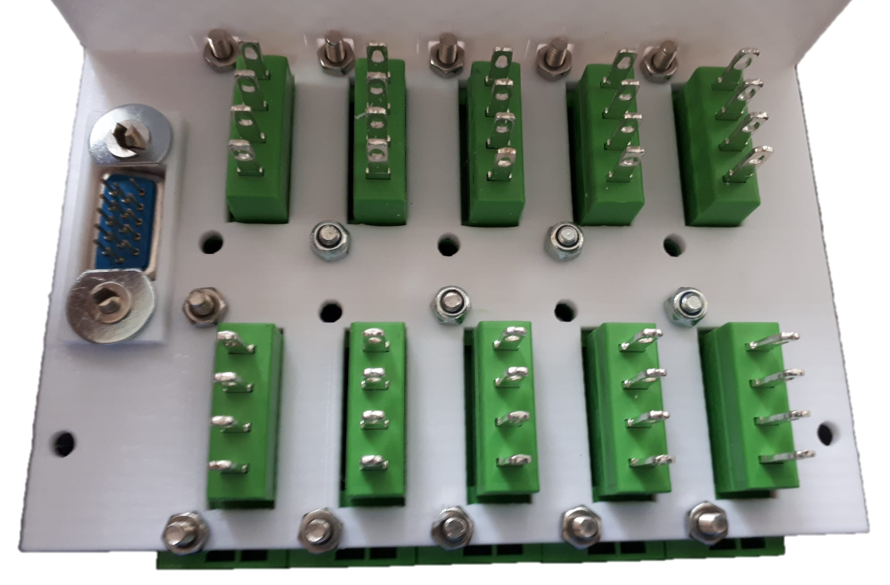
1
2
K
3
4
5
3
E
D
C
B
A
1
J
I
H
G
F
1
2
3
4

Slide 2
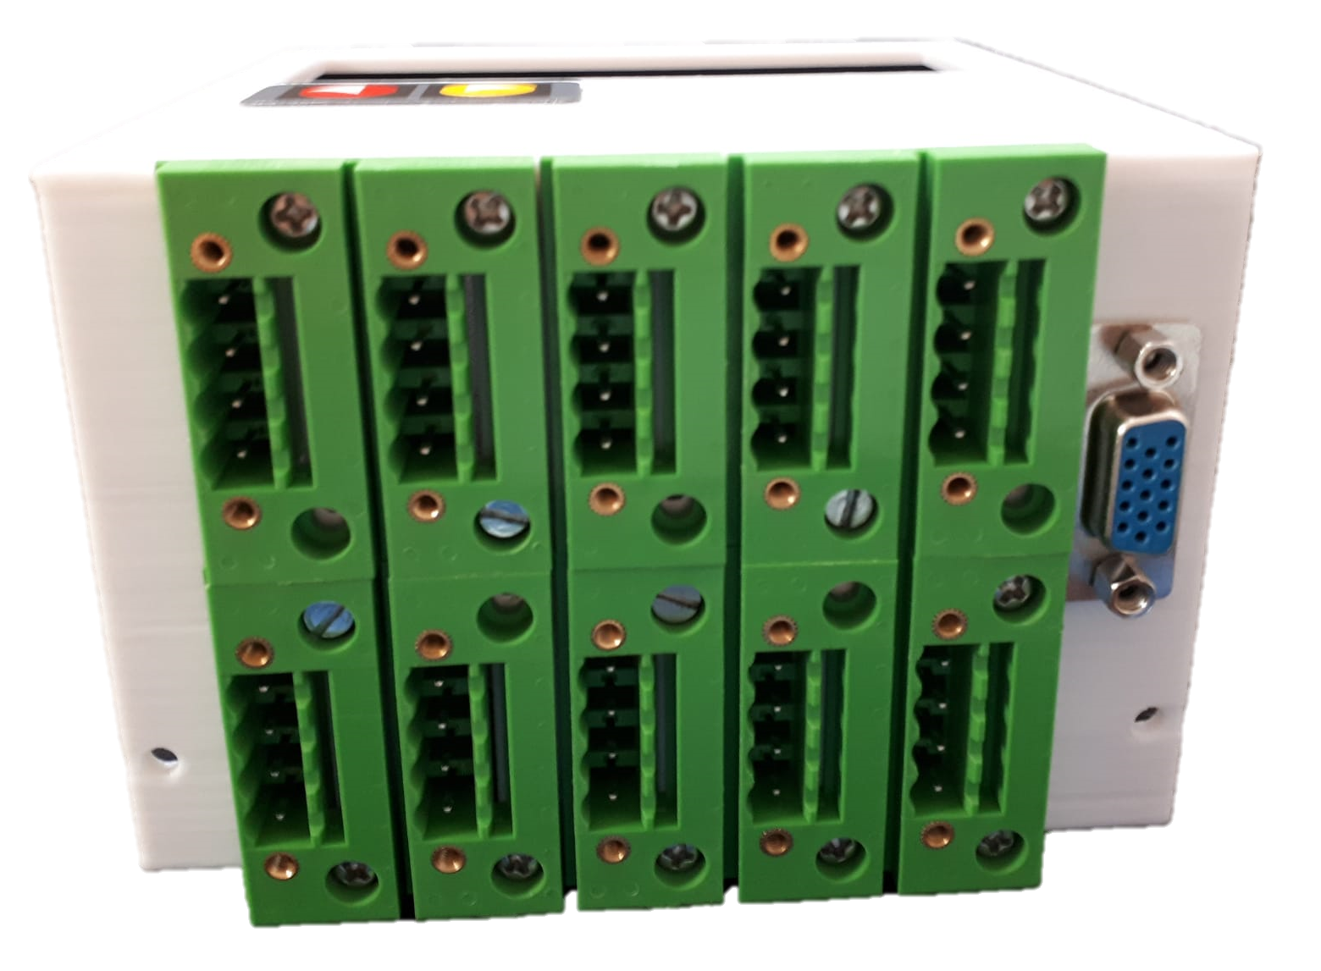
A
B
C
D
E
1
K
2
3
4
1
2
3
4
I
J
F
G
H

Slide 3
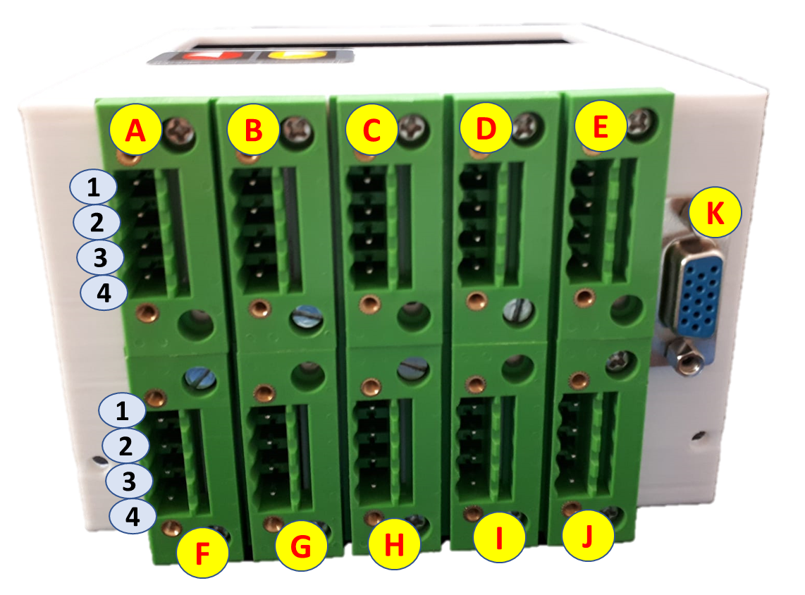
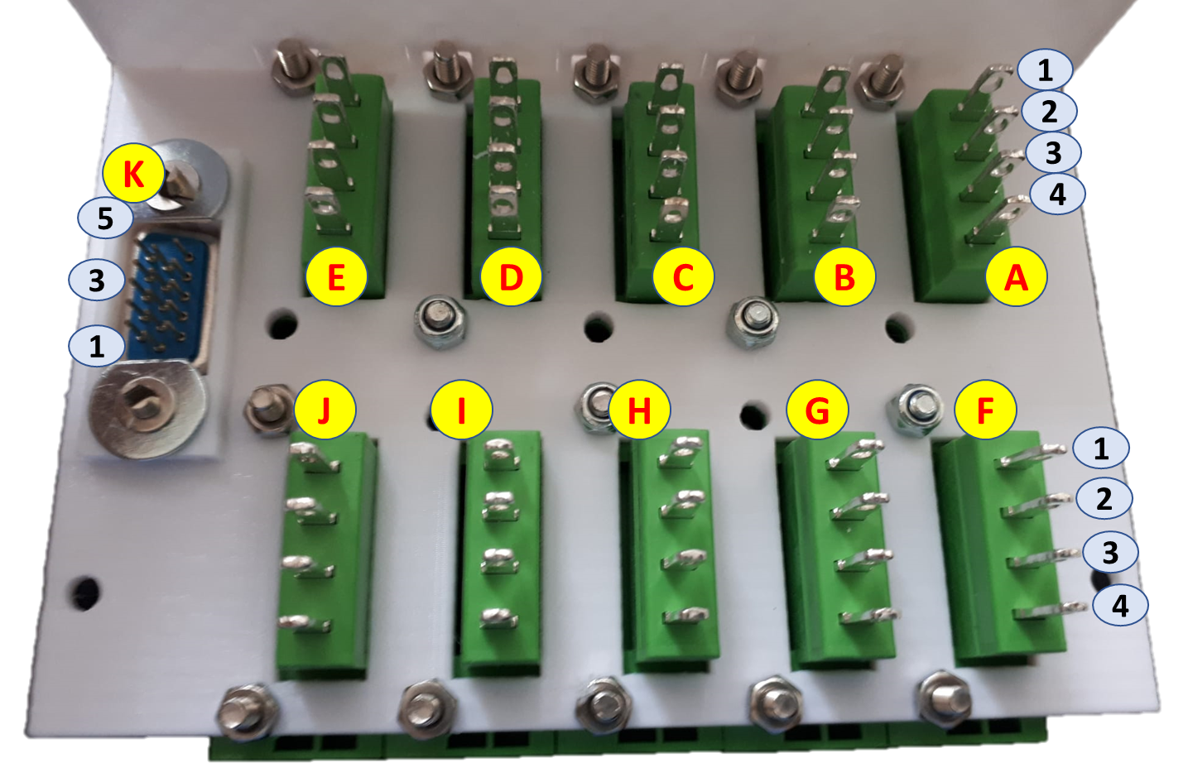
A. LIDAR
White. Lidar_Protect
Yellow. Lidar_Warning
Brown. Lidar_Dirty
Green. Lidar_Reset
B. Unasigned
C. SERIAL HLC
Black. –LLCtrl (5v)
Orange. TX0-PC
Gray. RX0-PC
D. Motor drive + Pinhook
Brown. Pinhook_a
White. Pinhook_b
Pink. Motor1_Pwm
Green. Motor2_Pwm
E. Button
Yellow. Pin_Button_Led
Black. –LLCtrl (5v)
White. Pin_ Button
Red. +LLCtrl (5v)
F. POWER
Orange. +LLCtrl (24v)
Gray. –LLCtrl (24v)
Red. +LLCtrl (5v)
Black. –LLCtrl (5v)
G. MAG Sensor
Blue. MSel1
Yellow. MSel2
White. MDev
Brown. MGate
H. Encoder 1
Yellow. Encoder 1A
Green. Encoder 1B
Red. +LLCtrl (5v)
Black. –LLCtrl (5v)
I. Encoder 2
Yellow. Encoder 1A
Green. Encoder 1B
Red. +LLCtrl (5v)
Black. –LLCtrl (5v)
J. Flexi
Blue. SafetyStop
Brown. Motors_Stop
White. Lidar_CaseBit0
Yellow. Lidar_CaseBit1
K. RFID interrogator
Orange. +LLCtrl (24v)
Purple. RFID TX
Gray. –LLCtrl (24v)
LLC Connectors

